Slide 1
Sequence Diagram
Software Design and Architecture

Slide 2
Interaction Diagrams
A series of diagrams describing the dynamic behavior of an object-oriented system.
  A set of messages exchanged among a set of objects within a context to accomplish a purpose.
Often used to model the way a use case is realized through a sequence of messages between objects.
Sequence Diagrams

Slide 3
Interaction Diagrams (Cont.)
The purpose of Interaction diagrams is to:
  Model interactions between objects
  Assist in understanding how a system (a use case) actually works
  Verify that a use case description can be supported by the existing classes
  Identify responsibilities/operations and assign them to classes
Sequence Diagrams

Slide 4
Interaction Diagrams (Cont.)
UML
  Collaboration Diagrams
  Sequence Diagram
Sequence Diagrams

Slide 5
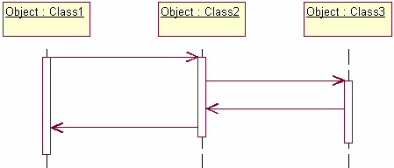
Sequence Diagram
Message1()
[Condition:]
Message2()
Message3()
Message4()

Slide 6
A First Look at Sequence Diagrams
Illustrates how objects interacts with each other.
Emphasizes time ordering of messages.
Can model simple sequential flow, branching, iteration, recursion and concurrency.
Sequence Diagrams

Slide 7
A Sequence Diagram
member:
LibraryMember
book:Book
borrow(book)
ok = mayBorrow()
[ok] borrow(member)
setTaken(member)
Sequence Diagrams

Slide 8
A Sequence Diagram
X-Axis (objects)
member:
LibraryMember
book:Book
Object
borrow(book)
ok = mayBorrow()
Life Line
Y-Axis (time)
message
[ok] borrow(member)
setTaken(member)
condition
Activation Box
Sequence Diagrams

Slide 9
Object
Object naming:
  syntax: [instanceName][:className]
  Name classes consistently with your class diagram.
The Life-Line represents the object’s life during the interaction
myBirthdy
:Date
Sequence Diagrams

Slide 10
Messages
An interaction between two objects is performed as a message sent from one object to another.
If object obj₁ sends a message to another object obj₂ some link must exist between those two objects (dependency, same objects)
Sequence Diagrams

Slide 11
Messages (Cont.)
A message is represented by an arrow between the life lines of two objects.
  Self calls are also allowed
  The time required by the receiver object to process the message is denoted by an activation-box.
A message is labeled at minimum with the message name.
  Arguments and control information (conditions, iteration) may be included.
Sequence Diagrams

Slide 12
Return Values
Optionally indicated using a dashed arrow with a label indicating the return value.
  Don’t model a return value when it is obvious what is being returned
  Model a return value only when you need to refer to it elsewhere, e.g. as a parameter passed in another message.
  Prefer modeling return values as part of a method invocation, e.g. ok = isValid()
Sequence Diagrams

Slide 13
Object Creation
An object may create another object via a <<create>> message.
:A
:B
Preferred
:A
<<create>>
<<create>>
:B
Constructor
Sequence Diagrams

Slide 14
Object Destruction
An object may destroy another object via a <<destroy>> message.
  An object may destroy itself.
  Avoid modeling object destruction unless memory management is critical.
:A
:B
<<destroy>>
Sequence Diagrams

Slide 15
Control information
Condition
  syntax: ‘[‘ expression ’]’ message-label
  The message is sent only if the condition is true
  example:
Iteration
  syntax: * [ ‘[‘ expression ‘]’ ] message-label
  The message is sent many times to possibly multiple receiver objects.
[ok] borrow(member)
Sequence Diagrams

Slide 16
Control Information (Cont.)
Iteration examples:
:CompoundShape
:Shape
:Driver
:Bus
draw()
*draw()
*[until full] insert()
The syntax of expressions is not a standard
Sequence Diagrams

Slide 17
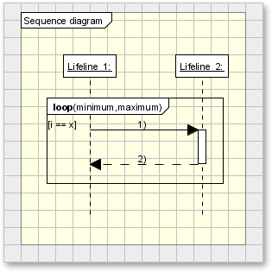
Iteration Example:

Slide 18
Contd..
In ATM example, the “Withdraw Money” use case, has several alternate flows. Therefore there will be several Interaction Diagrams.
A “happy day” Interaction Diagram shows what happens when all goes well
There are additional Interaction Diagrams to show alternate flows, for e.g.
  What happens when the user enters a wrong PIN
  What happens when there isn’t enough money in the account to be withdrawn etc.

Slide 19
Sequence Diagram Contd..
Lets take the basic flow where, say for e.g.
“Joe withdraws $20 from the ATM”
Objects?
  Card Reader
  ATM Screen
  Joe’s Account
  Cash Dispenser
A good way to identify the objects is to examine nouns in your flow of events. Some of the nouns will be actors , some will be objects, some will be attributes of the objects. The noun having some behaviour is an object. The one which is an information is just an attribute.

Slide 20
Sequence Diagram Contd..
Joe withdraws $20 from the ATM (flow of events)
  The process begins when Joe inserts his card into the card reader. The card reader reads the number on Joe’s card, then tells the ATM screen to initialize itself
  The ATM prompts Joe for his PIN.
  Joe enters PIN and the ATM opens his account
  Joe’s PIN is validated and the ATM prompts him for a transaction
  Joe selects Withdraw Money
  The ATM prompts Joe for an amount.
  Joe enters $ 20.
  The ATM verifies that Joe’s account has sufficient funds and subtracts $ 20 from his account.
  The ATM dispenses $ 20 and ejects Joe’s card

Slide 21
